Slide 1
ROCKBUSTER STEALTH
BUSINESS STRATEGY MEETING FOR NEW ONLINE VIDEO SERVICE
BY: PADMASINI VENUGOPAL

Slide 2
ABOUT ROCKBUSTER
Rockbuster Stealth is a movie rental company that has a worldwide market. Facing stiff competition from streaming services such as Netflix and Amazon Prime, the Rockbuster Stealth management team is planning to use its existing movie licenses to launch an online video rental service in order to stay competitive.”

Slide 3

contents
1 - MOVIES: Which movies contributed the most/least to revenue gain?
2 – DURATION OF RENTALS: What was the average rental duration for all videos?
3 – CUSTOMERS: Which countries have the most customers and which countries have the most lifetime value customers?
4 – SALES REVENUE: Do sales figures vary between geographic regions?

Slide 4
Data overview
RENTAL RATE
$0.99- $4.99
RENTAL DURATION
3-7 DAYS
TOTAL NO OF MOVIES
1000
MOVIE RATINGS
G (178), PG (194), PG - 13 (223), R (195), NC-17 (210)
NO OF ACTIVE USERS
584
AVERAGE FILM LENGTH
115 MINUTES

Slide 5
Movies & REVENUE

Slide 6
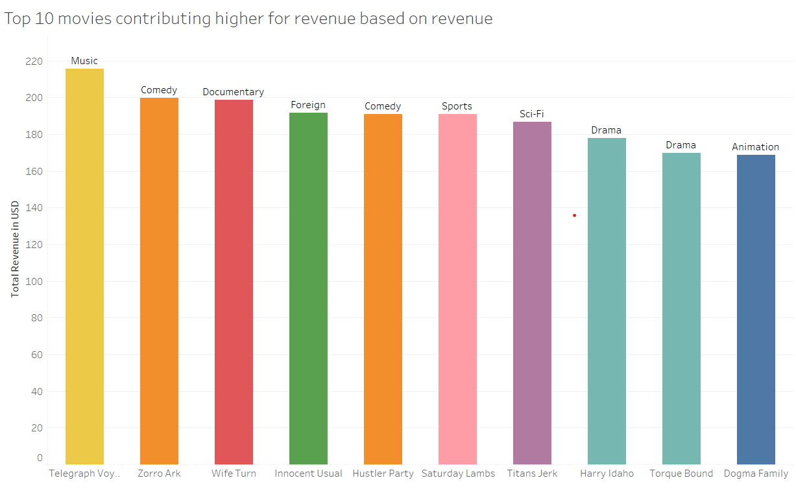
The top 10 movies having high revenue
The top movies which contribute the high revenue belong to music, comedy, and documentary genres. The name of the movies is Telegraphic Voyage, Zorro Ark and wife turn.

Slide 7
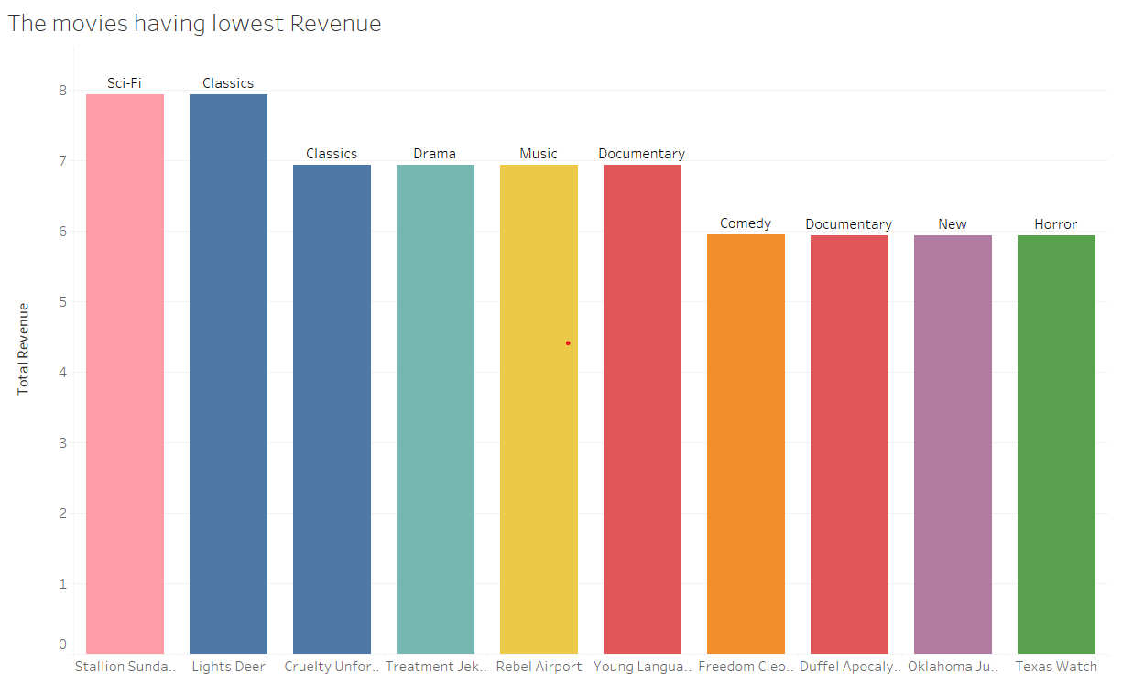
The movies having the lowest revenue
The movies having the lowest revenue belong to the new and horror genres. The name of the movie is Texas Watch and Oklahoma Jumanji.

Slide 8
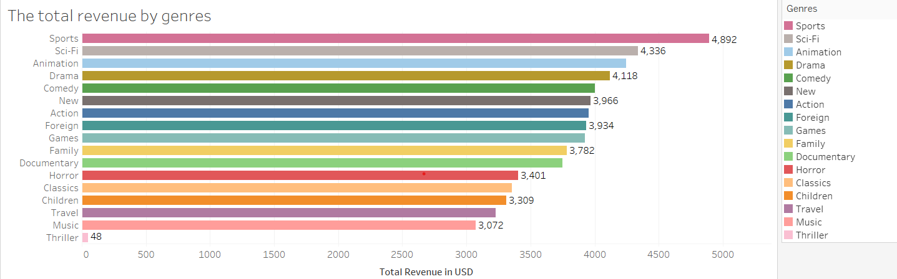
The total revenue with genres
From the analysis, it’s very clear that the sports genre movie is the high contributor to the total revenue followed by it is science fiction, animation, drama and comedy.

Slide 9
The average rental duration

Slide 10
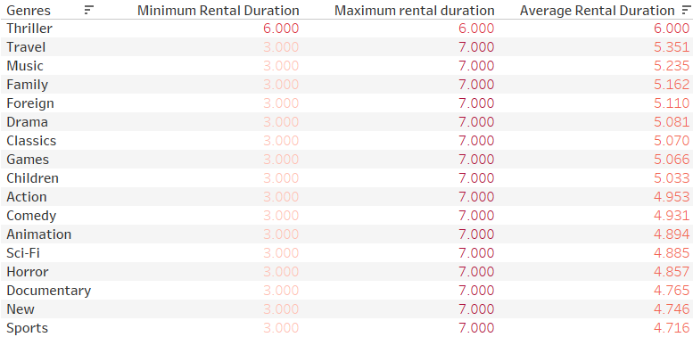
The rental duration is explained here with a packed bubble chart.
By analyzing the average rental duration among different genres it is approx. 5.03 days and it is very clear that the Thriller genre has been rented longer.
It’s surprising to know, that despite having only one film, the thriller genre has the highest rental duration.

Slide 11
The customers

Slide 12
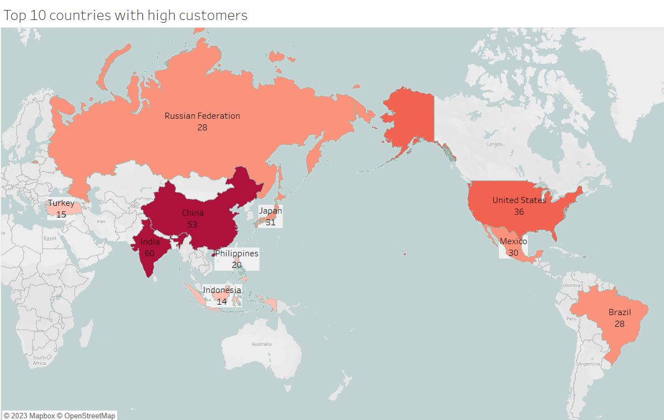
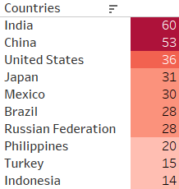
Geographic distribution among countries

Slide 13
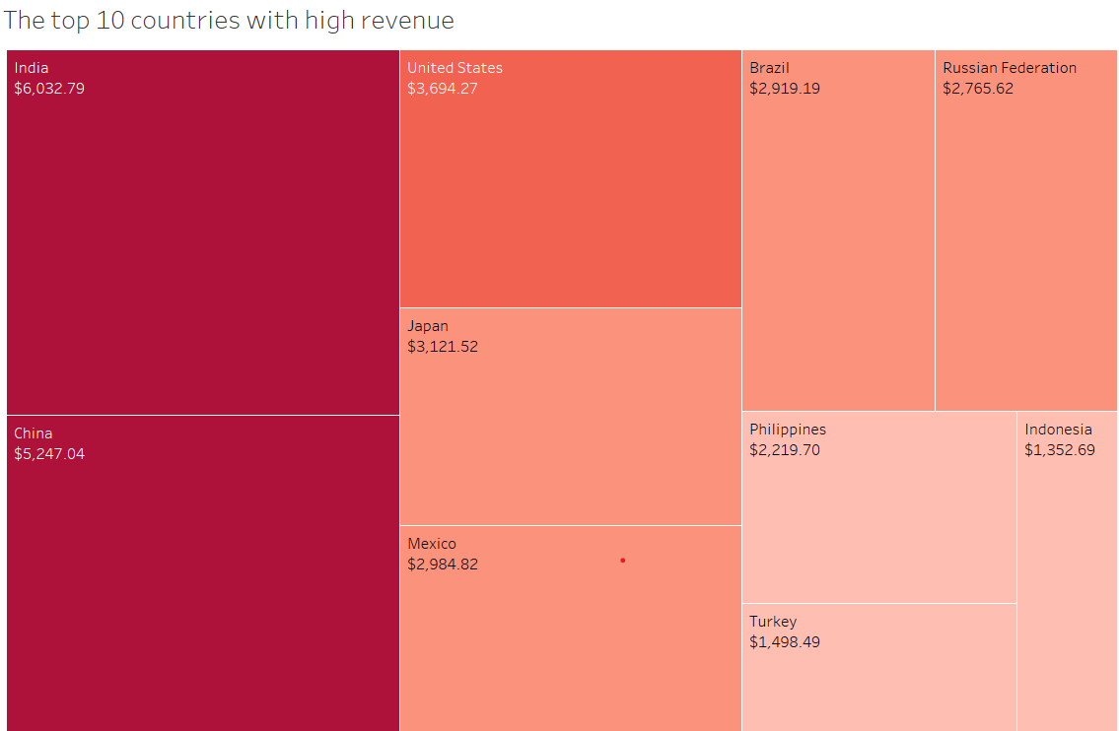
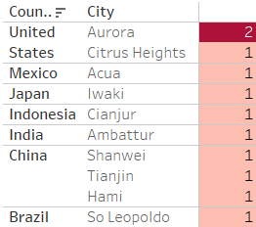
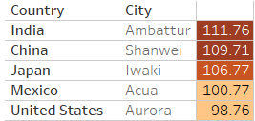
The top 10 cities with the highest number of customers within the top 10 countries
The top 5 customers from that top cities, who have paid the highest amount

Slide 14
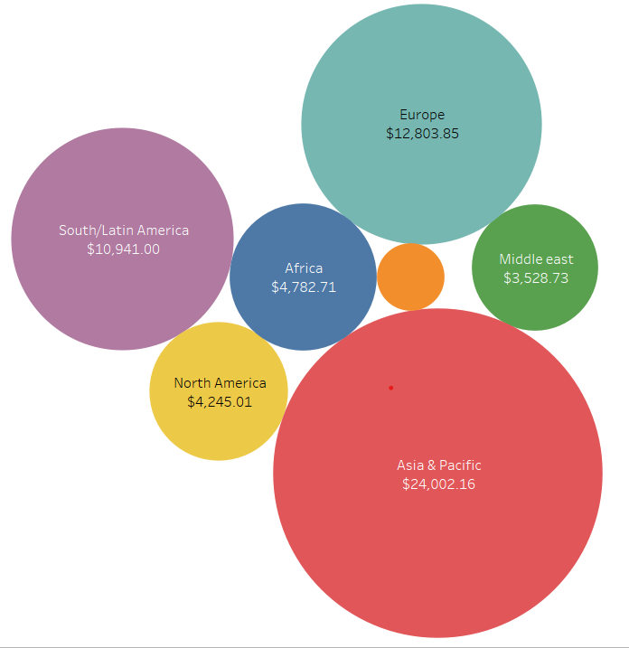
Sales by geographic regions
Most of Rockbuster’s total revenue comes from Asia & Pacific, Europe, and South/Latin America.

Slide 15
Conclusions
The top genres that contribute to high sales are science fiction, animation, drama, and comedy.
Telegraph Voyage, Zorro Ark, and Wife Turn movies contribute to the most revenue gain.
The movies Texas Watch and Oklahoma Jumanji contribute the least revenue.
The Average rental duration of the movies is 5.03 days and the Thriller genre has been rented longer for almost 6 days when compared to others.
The top 10 countries having higher customer count is India, China, the United States, Japan, Mexico, Brazil, Russian Federation, Philippines, Turkey, and Indonesia.
The top 5 customers from the top cities, who have paid the highest amount are from Ambattur, Shanwei, Iwaki, Acua, and Aurora.
The highest total revenue of Rockbuster comes from Asia & Pacific, Europe, and South/Latin America.

Slide 16
RECOMMENDATIONS
A special focus has to be given to certain movies that generate higher revenue rather than going on certain genres, it’s also better to remove a few movies which have the least revenue.
Special offers can be introduced to people who hire the movies for more than 5 days which could lead to a significant increase in rental duration days.
Should increase the marketing strategies to our major markets Asia & pacific, Europe, and South/Latin America. Marketing promotions should be done in other regions also to increase sales.
The top 5 countries should be taken to count and we can introduce more movies in their preferable language which can create more interest among people and will improvise our sales.
The High paid customers should be rewarded for their loyalty and we should also include the referral codes system which helps in increasing the customer numbers.

Slide 17
THANK YOU!
https://public.tableau.com/app/profile/padmasini.venugopal/viz/Task3_10-Rockbusterpresentation/Salesbygeographicregions
For further queries kindly contact
drpadmasini.v@gmail.com

